Slide 1
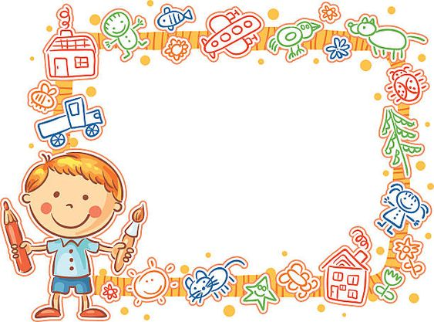
Uvítanie žiakov
Vitajte
v 2.A
Spracovala: Mgr. Renáta Kollárová

Slide 2
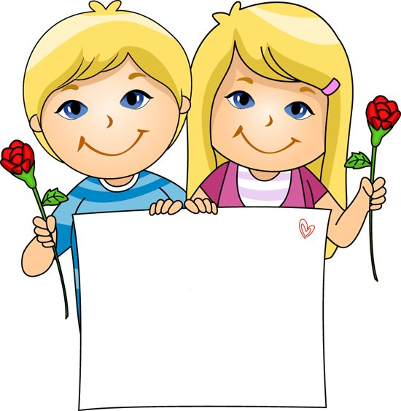
Vitajte
v škole
žiaci ☺

Slide 3

Vitajte v 3.B

Slide 4

Škola volá ☺

Slide 5
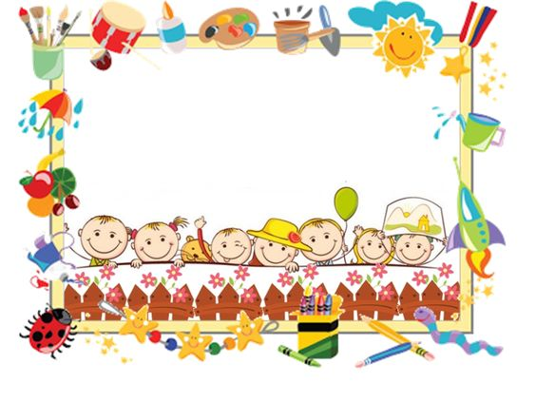
Vitajte v škole☺

Slide 6
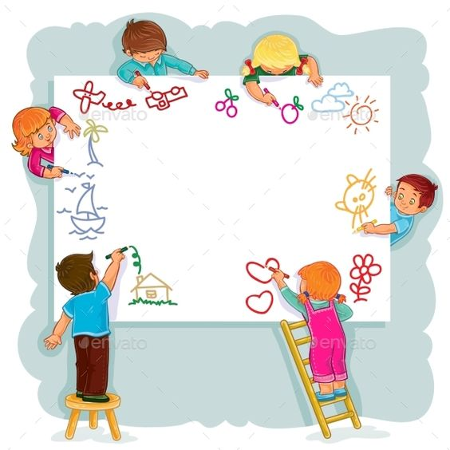
Škola volá

Slide 7

Vitajte
žiaci ☺

Slide 8

Škola volá

Slide 9

Vitajte
v 1. A

Slide 10
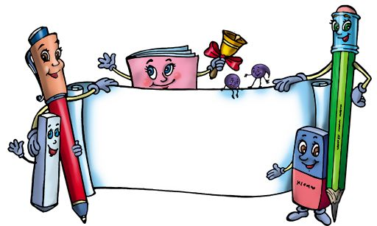
Škola volá!

Slide 11
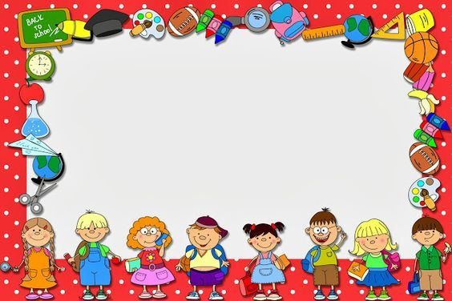
Vitajte v škole!

Slide 12
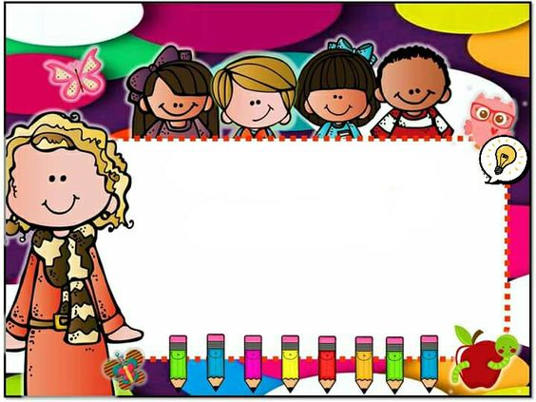
Škola volá!

Slide 13

Vitajte
v 2. A triede

Slide 14
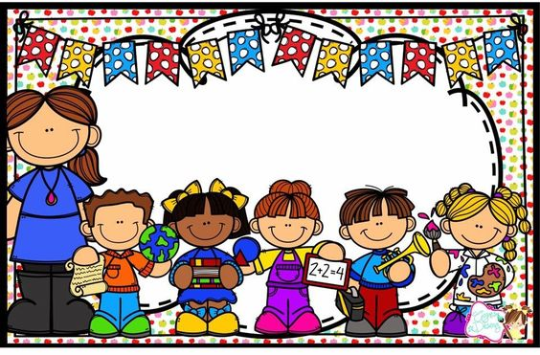
Vitajte v 1. A triede

Slide 15
Vitajte
opäť
v škole
žiaci ☺

Slide 16
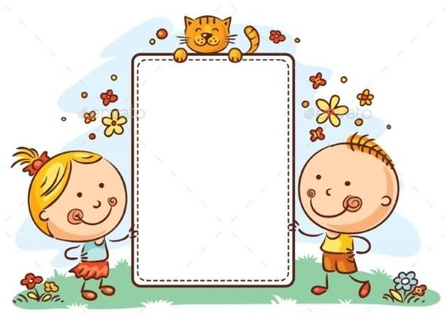
Hurá
do školy
druháci !

Slide 17

Škola volá!

Slide 18
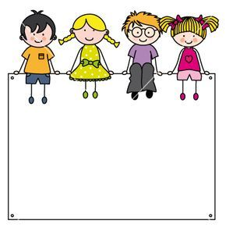
Vitajte
v 2. B triede

Slide 19
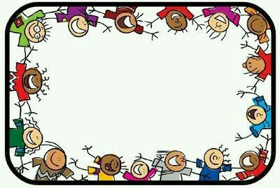
Vitajte v škole!

Slide 20
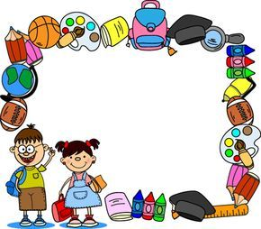
Hurá škola

Slide 21

Zdroje
https://sk.pinterest.com/pin/330522060146020750
/https://sk.pinterest.com/pin/606508274787659315/
https://sk.pinterest.com/pin/311663236696503437/
https://sk.pinterest.com/pin/451767406361493591/
https://sk.pinterest.com/pin/407857309981443380/
https://sk.pinterest.com/pin/798192733928734773/
https://sk.pinterest.com/pin/436075176413168595/
https://sk.pinterest.com/pin/798192733928734773/
https://sk.pinterest.com/pin/436075176413168595/
https://sk.pinterest.com/pin/734931232914407736/
https://sk.pinterest.com/pin/688769336732257556/
https://sk.pinterest.com/pin/643944446694668932/
https://sk.pinterest.com/pin/311663236697872932/
https://sk.pinterest.com/pin/747245763144592229/
https://sk.pinterest.com/pin/425660602272852995/
https://sk.pinterest.com/pin/854769204251242912/
https://sk.pinterest.com/pin/333899759864808664/
https://sk.pinterest.com/pin/779052435512818262/
https://sk.pinterest.com/pin/689050811707841794/
https://sk.pinterest.com/pin/406590672599212296/
https://sk.pinterest.com/pin/304837468503800947/
Vitajte
v 3. A
žiaci

